Slide 1
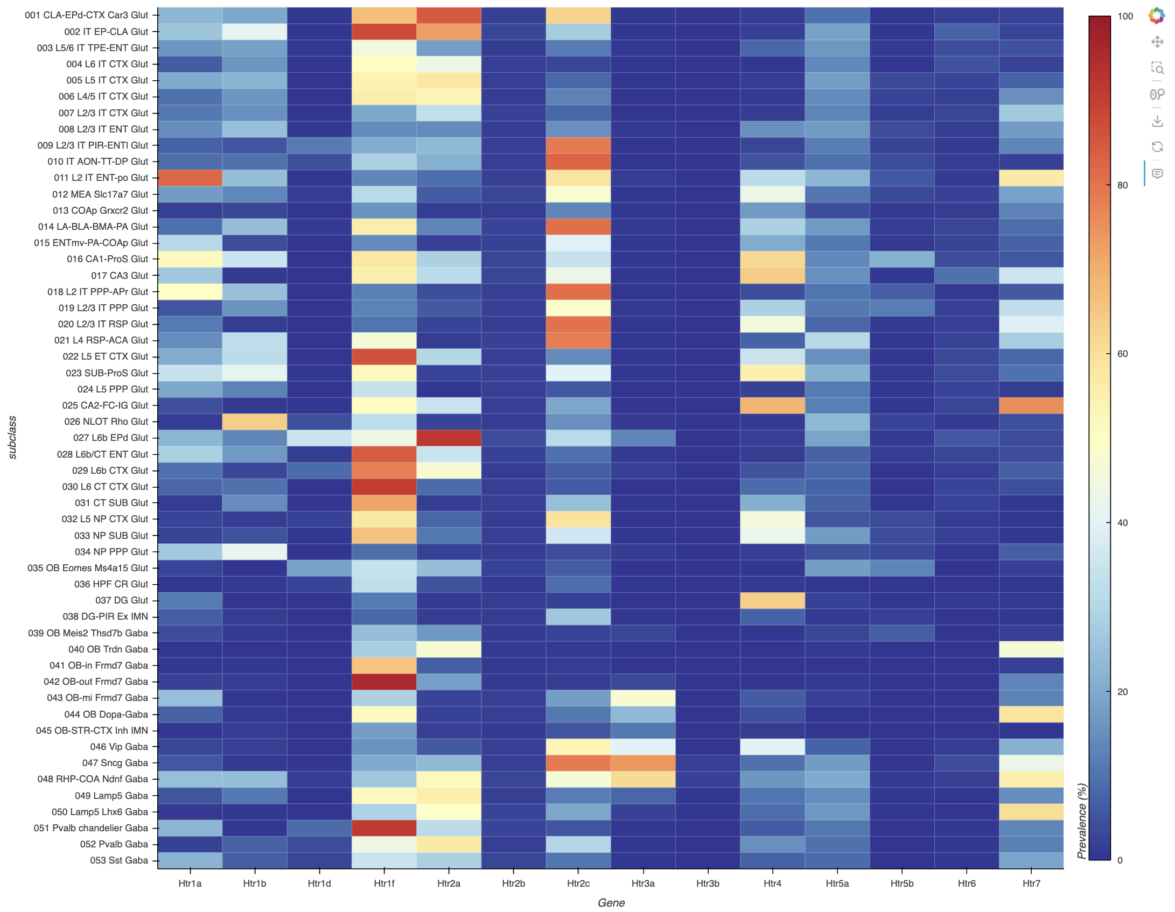
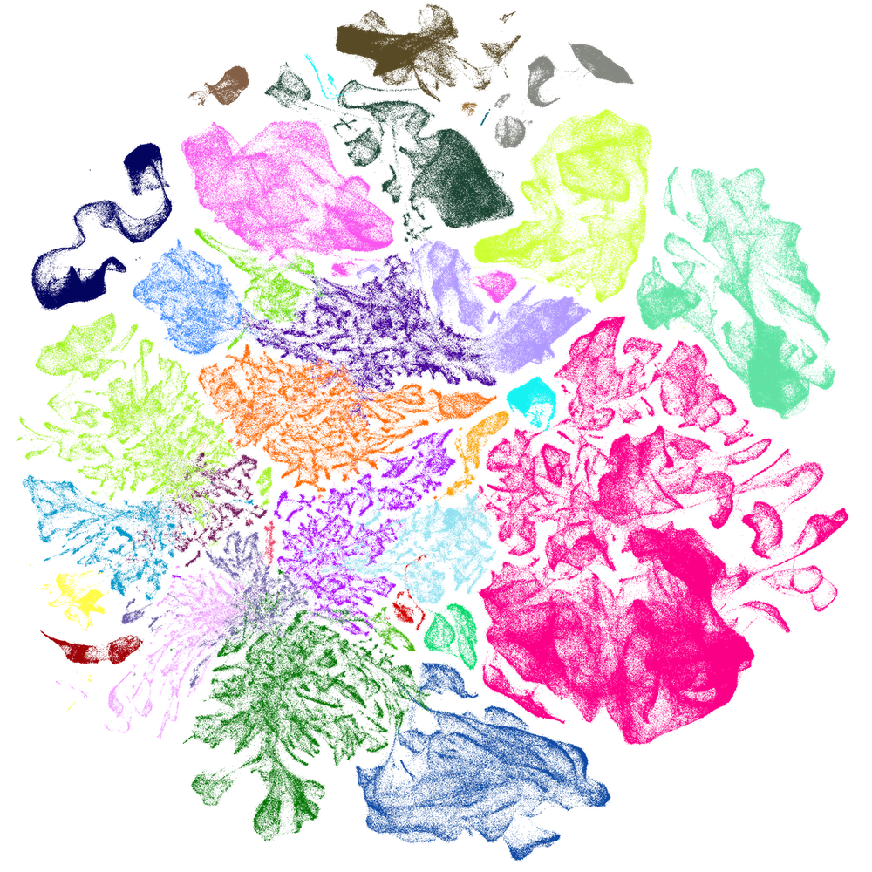



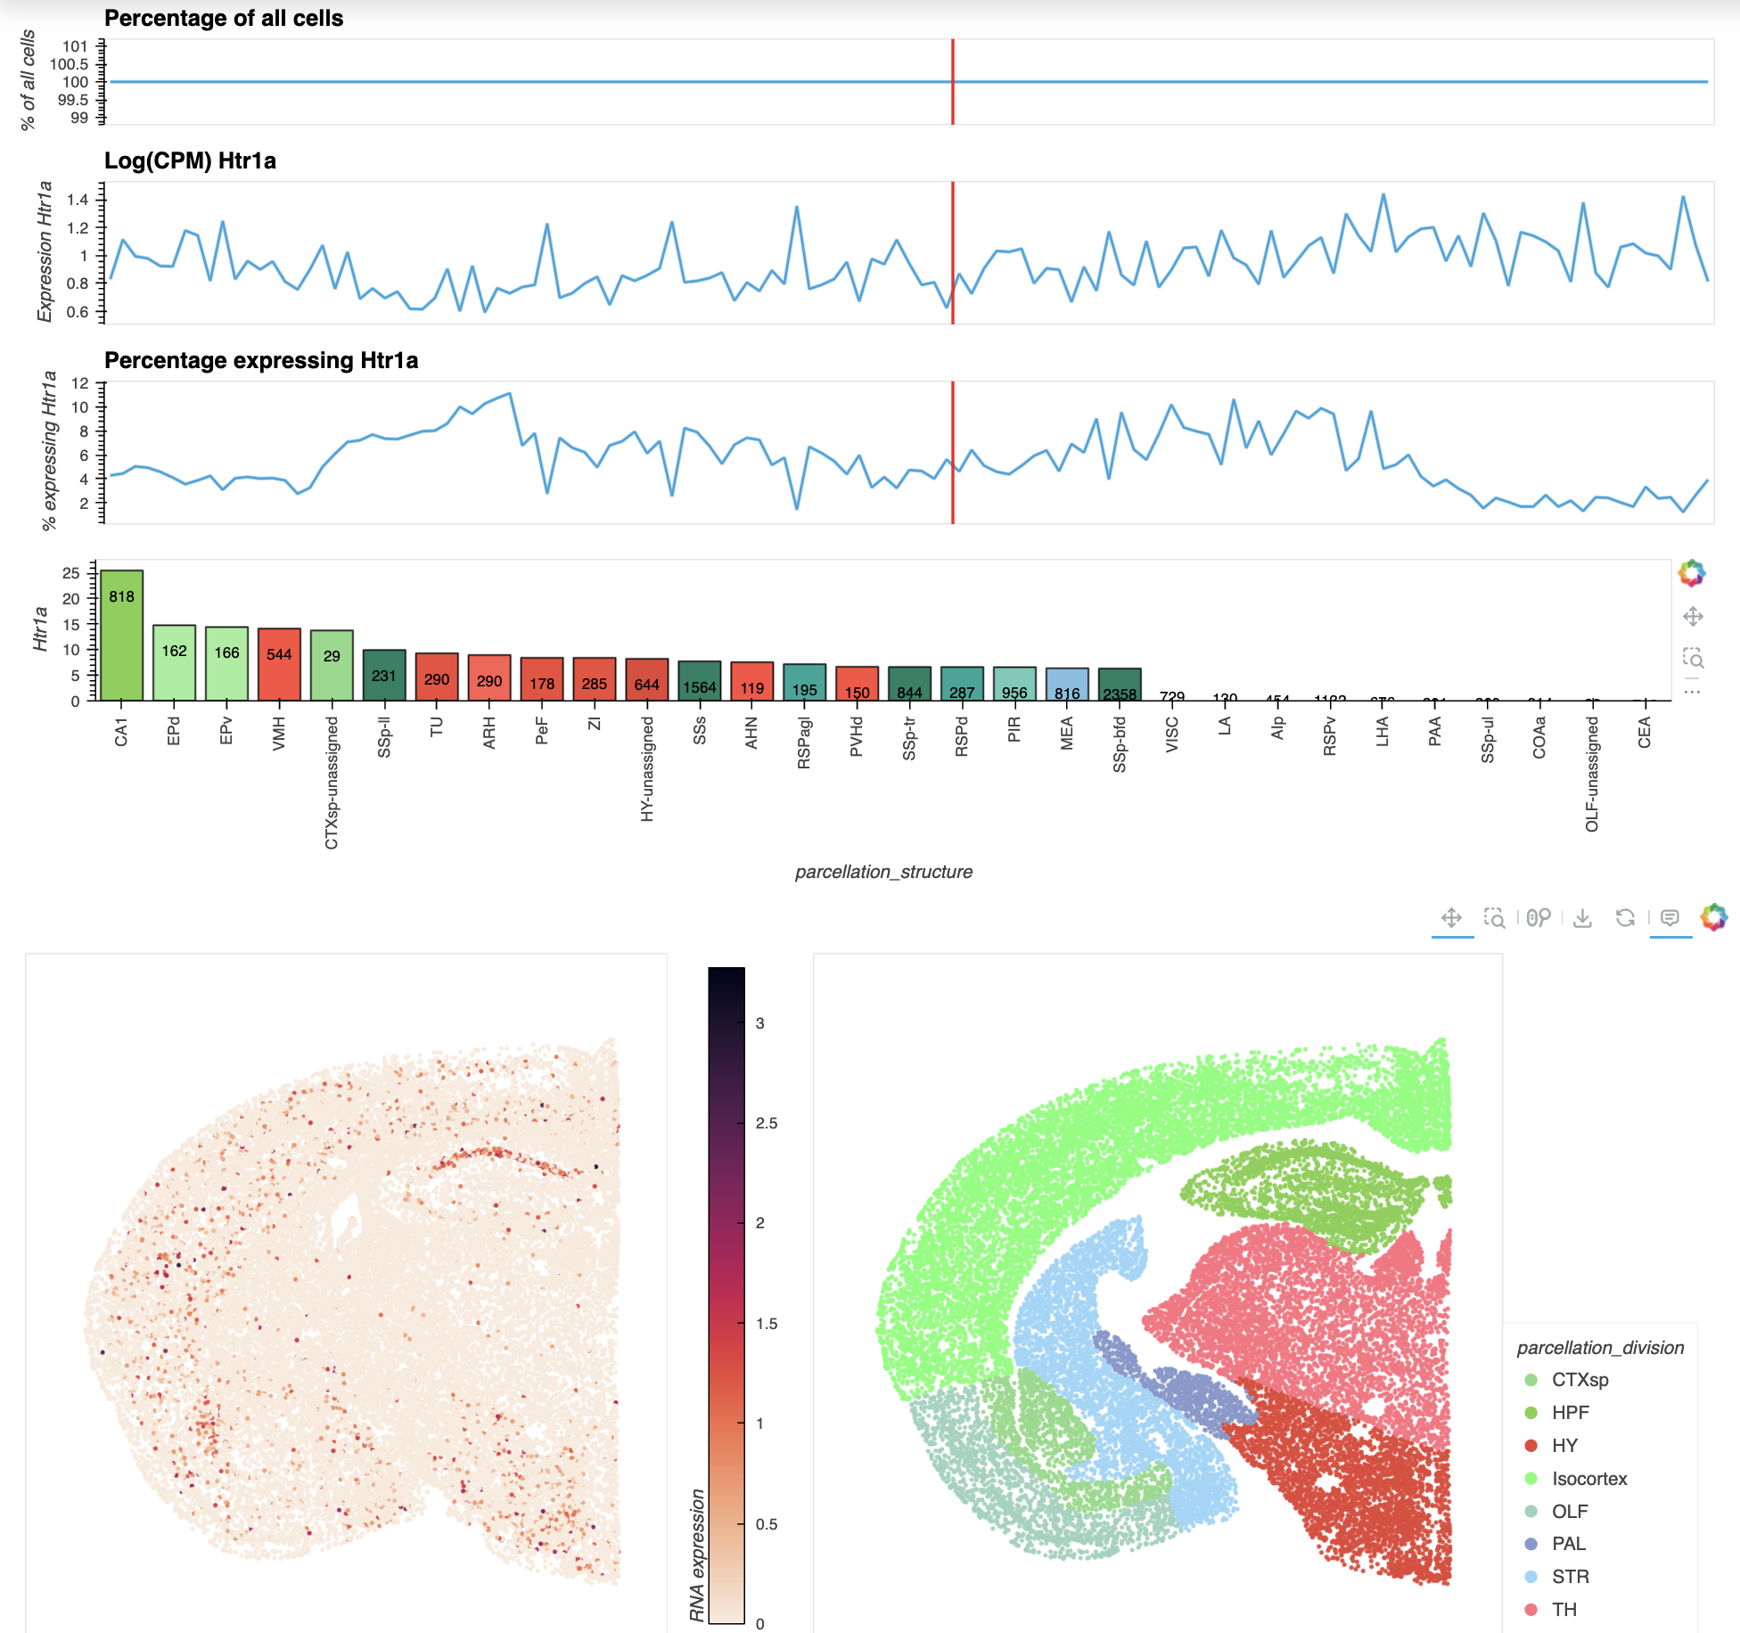






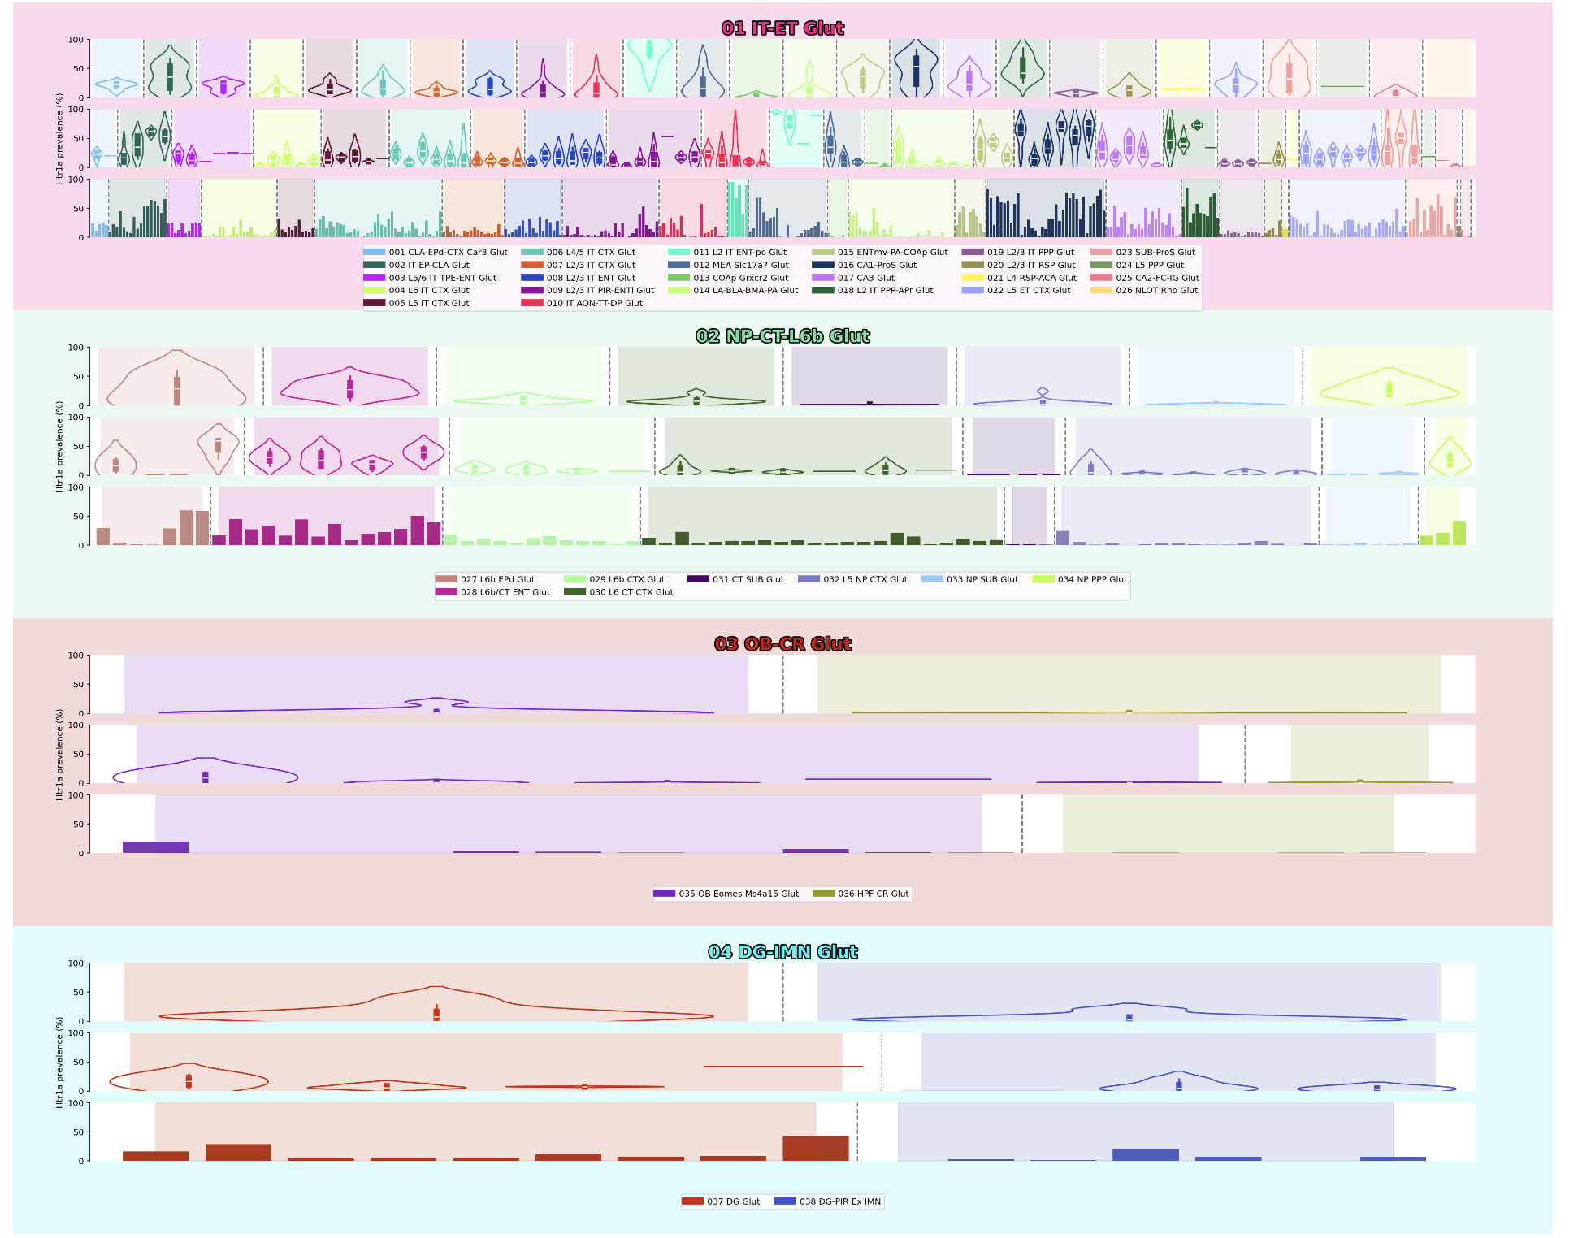
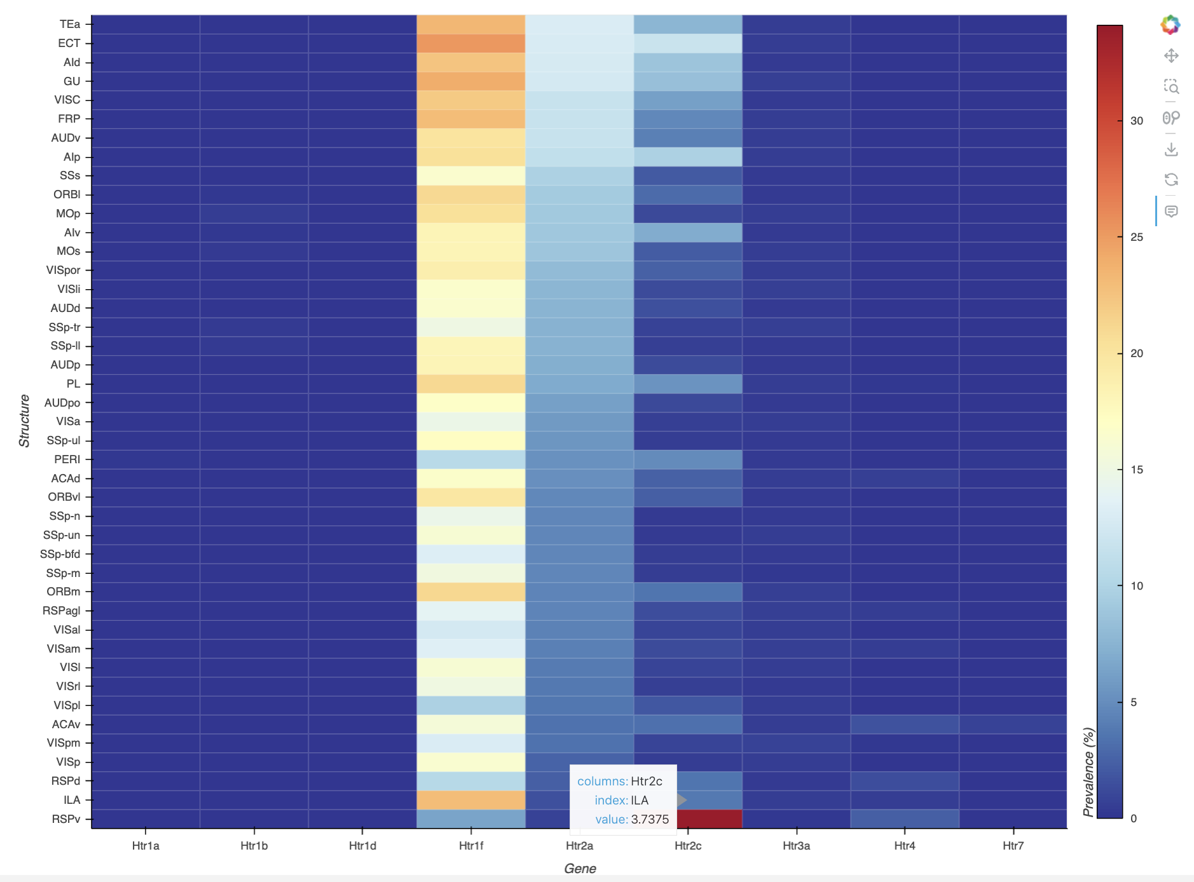
MOUSE WHOLE-BRAIN TRANSCRIPTOMIC CELL TYPE ATLAS
Overview genes by class/subclass
MERFISH
scRNA-seq
Data analysis and manipulation
Spatial MERFISH
INTERACTIVE VISUALIZER
Hosted online on:
Gene by class/subclass/supertype/cluster
Overview genes by brain structure

